Slide 1

Orcsoft Internal Workshop
Offer Reliable Computing Services On Future Technology

Slide 2
** Before start the section ** First of all, let me introduce my self to you
Name : Parwin Rungpiriyadej { PED }
Work : KTB
Email : parwin@orcsoft.co.th
How about you ?

Slide 3
Day 8 : JSON & jQuery

Slide 4
JSON { JavaScript Object Notation }
is lightweight text-based open standard designed for human-readable data-interchange.
is language independent.
is easy to read and write.
filename extension is .json
internet media type is application/json

Slide 5
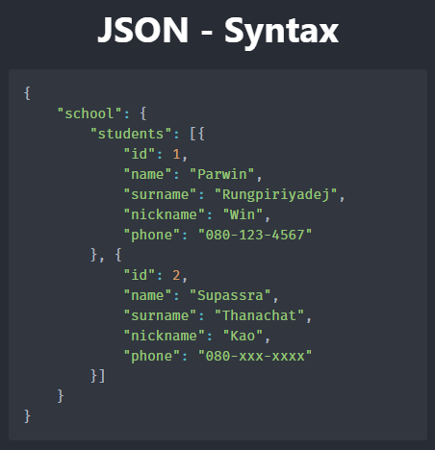

Slide 6
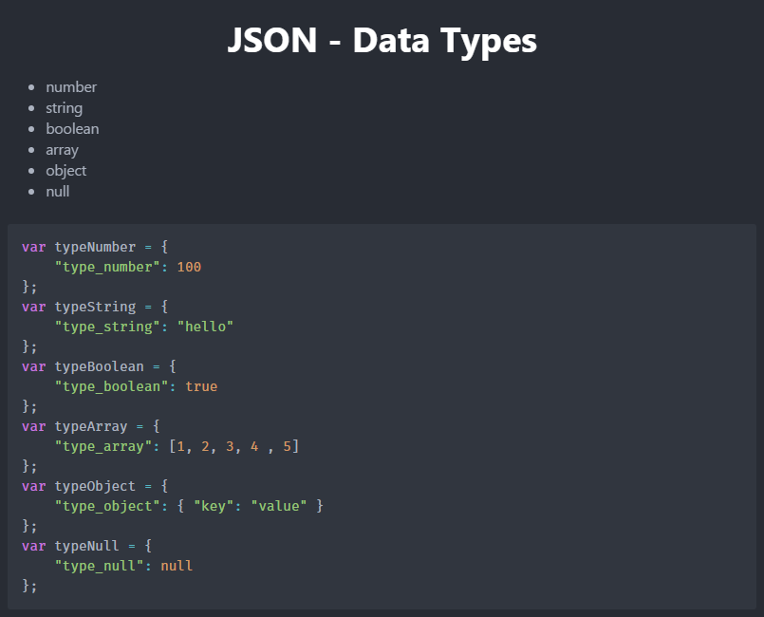

Slide 7
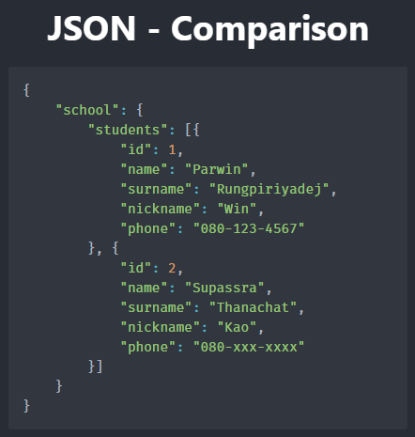
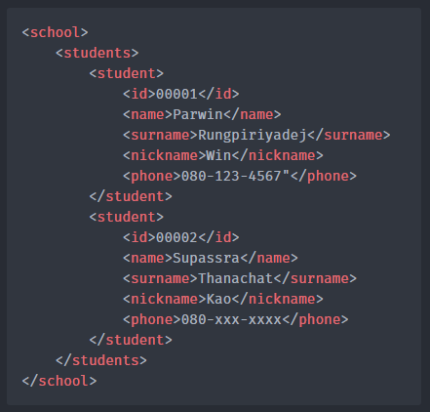

Slide 8
JSON { How to }

Slide 9
JSON { Assignment }

Slide 10
jQuery { What is jQuery ? }
jQuery is a Javascript Library.
jQuery is to make it much easier to use Javascript.
jQuery library contains HTML document traversal and manipulation, event handling, animation, and Ajax

Slide 11
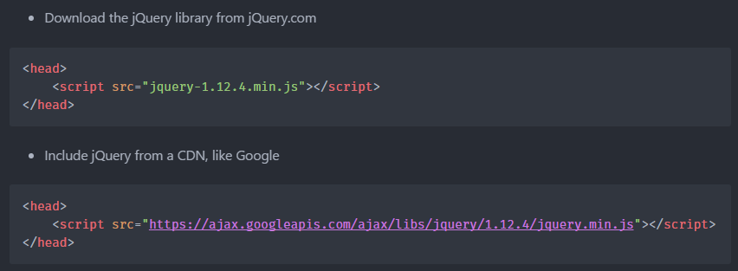
jQuery { Get Started }

Slide 12
jQuery { Syntax }
Basic syntax is $(selector).action()

Slide 13
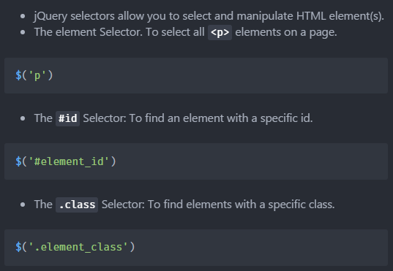
jQuery { Selector }

Slide 14
jQuery { get/set content and attributes }
Three simple, but useful, jQuery methods for DOM manipulation are:
text() - Sets or returns the text content of selected elements
html() - Sets or returns the content of selected elements (including HTML markup)
val() - Sets or returns the value of form fields

Slide 15
jQuery { get/set content and attributes }
Get/Set Attributes - The jQuery attr() method is used to get attribute values

Slide 16
jQuery { Add Element }
append() - Inserts content at the end of the selected elements
prepend() - Inserts content at the beginning of the selected elements
after() - Inserts content after the selected elements
before() - Inserts content before the selected elements

Slide 17
jQuery { Remove Element }
remove() - Removes the selected element (and its child elements)
empty() - Removes the child elements from the selected element

Slide 18
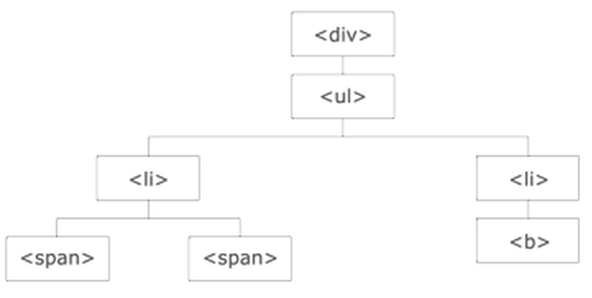
jQuery { Traversing Element }
parent() - returns the direct parent element of the selected element.
Example: $(‘span’).parent();

Slide 19
jQuery { Traversing Element }
children() - returns all direct children of the selected element.
Example: $(‘div’).children();

Slide 20
jQuery { Traversing Element }
find() - returns descendant elements of the selected element, all the way down to the last descendant.
Example: $(‘div’). find("span");

Slide 21
jQuery { Traversing Element }
siblings()
next()
nextAll()
prev()
prevAll()

Slide 22
jQuery { Traversing Element }
first() - $("div li").first();
last() - $("div li").last();
eq() - $(“span").eq(1);
filter() - $(“span").filter(".intro");
not() - $(“span").not(".intro");

Slide 23
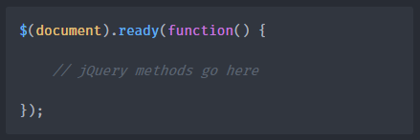
jQuery { Document Ready Event }
To noticed that all jQuery methods in our examples, are inside a document ready event:

Slide 24
jQuery { Events }
What are Events?
All the different visitor's actions that a web page can respond to are called events.
An event represents the precise moment when something happens.

Slide 25
jQuery { Events }
Examples:
moving a mouse over an element
selecting a radio button
clicking on an element

Slide 26
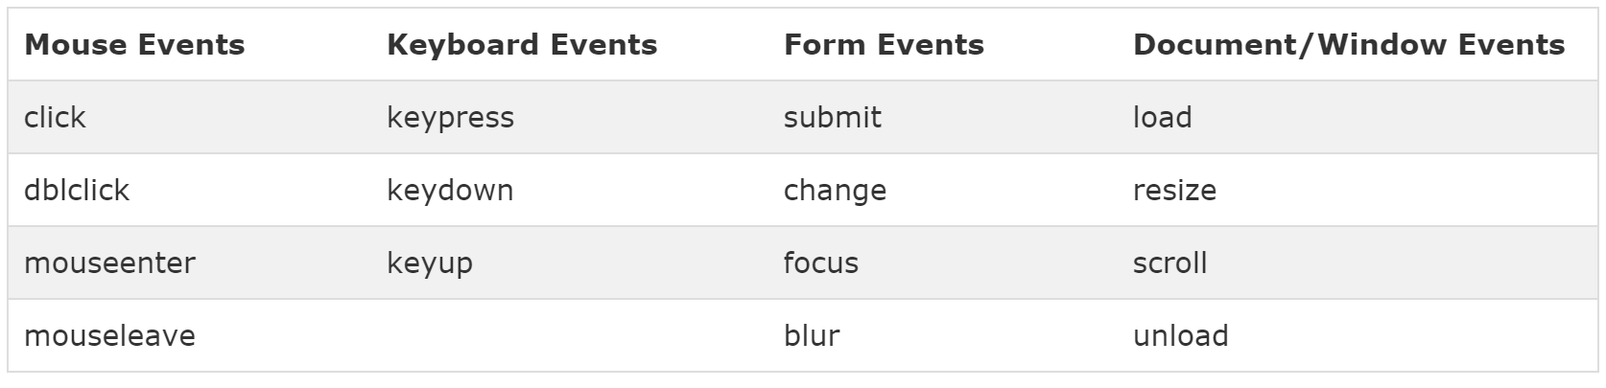
jQuery { Events }

Slide 27
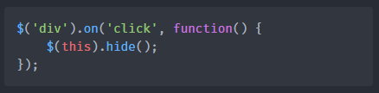
jQuery { Events }

Slide 28
jQuery { Let do it! }
http://try.jquery.com/

